Slide 1

Effective Mobile Automation
Péter Földházi Jr.
peter_foldhazi@epam.com

Slide 2
Table of Contents
Emerging Area
Mobile Automation Basics
Tools
Trilayer Framework
Testing Models

Slide 3
1. EMERGING AREA

Slide 4

Emerging Area
Increase in mobile testing
Mobile gadgets have overtaken the desktop market
Fast growing
New brands & technologies

Slide 5
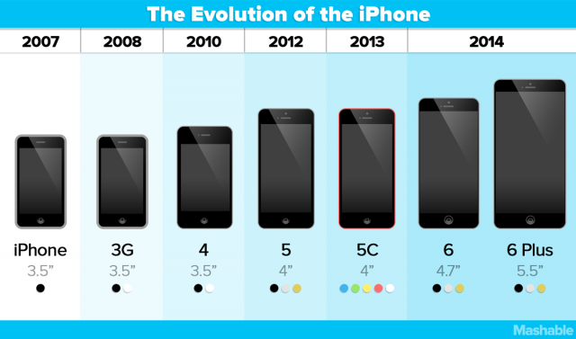
Emerging Area
Limitations & Setbacks => Challenges
Platforms
OS versions
Screen resolutions
Manufacturers
Costs
Young industry
Credit: www.mashable.com

Slide 6




Emerging Area
EPAM Solutions
Searching and sharing best practices (like regular Mobile Meetups)
Continuous Proof of Concept (POC)
Integration to test management tools
150 Mobile Test Engineers
8% of EPAM test division
15 Projects with Mobile Automation
79% testing integrated to CI
Data extracted from 2013 reports

Slide 7
2. AUTOMATION BASICS
Mobile

Slide 8

Automation basics
Processing test cases for automation
CREATE
AUTOMATE
PRIORITIZE
MERGE
QA Team
Automation Team

Slide 9



Automation basics
Mobile specific fields
Web Apps
Native Apps
Mock data (sensors, GPS etc.)
Credit for miCoach Smart Run image: www.bbc.com

Slide 10
3. TOOLS

Slide 11




Tools
UIAutomation (Apple)
Robotium (Renas Reda)
Espresso (Google)
Appium (Sauce Labs)
Examples
UIAutomation
UIATarget.localTarget().frontMostApp().mainWindow().scrollViews()[0].
tableViews()[1].cells(4).tap();
Robotium
solo.clickOnText("More");
Espresso
onView(withId(R.id.button_simple)).perform(click());
Appium
driver.findElementsByClassName("android.widget.Button");
driver.findElementsByClassName("UIAButton");

Slide 12
4. FRAMEWORK
Trilayer

Slide 13

Framework
Facade pattern
Simplified interface to a larger body of code.
Software library easier to use
Library more readable
Reduce dependencies
Wrap a poorly designed collection of APIs

Slide 14
Framework
Framework layers
Core layer: basic framework (i.g: Robotium) + basic functions
Inter layer: application dependent functions
Test layer: test scripts

Slide 15
5. TESTING MODELS
Automation methodologies

Slide 16

Testing Models
What are Structure Models?
Elements referred to as page objects
Objects of a screen build the model
Individual structure models
App structure
The testLogin script’s implementation:
solo.clickOnView(mainPage.loginButton);
solo.clickOnEditText(loginPage.username);
solo.typeText(loginPage.username, „DonaldDuck");
solo.clickOnEditText(loginPage.password);
solo.typeText(loginPage.password, „iLoveM33tingZ");
solo.clickOnView(loginPage.loginButton);
Assert.equals("Welcome, DonaldDuck" profilePage.Title);

Slide 17
Testing Models
Modelling Test Flows
User actions in a given order
Focusing on the flow
Objects unrelated
The testLogin script’s implementation:
login.start();
login.typeUsername("Lose");
login.typePassword("TheGame");
login.end();

Slide 18
Testing Models
Combining the two models
Create structure models
Make flows using their objects
Structure model: the point from where you go
Flow model: the rout you take to get to the next point
Click Username Edittext
Main Page
Login Page
Profile Page
Click Login Button
Click Login Button
Click Logout Button

Slide 19
Testing Models
Combining the two methodologies
The login class’ implementation using page models:
public login.start() {
solo.clickOnView(mainPage.loginButton));
}
public login.typeUsername(String username) {
solo.typeText(loginPage.username, username);
}
public login.typePassword(String password) {
solo.typeText(loginPage.password, password);
} public login.end() {
solo.clickOnView(loginPage.loginButton);
}

Slide 20
Testing Models
Same test script
The testLogin script’s implementation:
login.start();
login.typeUsername(„MidOrFeed");
login.typePassword(„L4sthiTiSm1ne");
login.end();

Slide 21
Conclusion
Conclusion
Numerous obstacles
Industry still too young
Patterns for automation

Slide 22
KÖSZÖNÖM!
peter_foldhazi@epam.com

